Slide 1
General Physics
Phs 101 (A)/ Physics
I. C. OKEYODE

Slide 2
FRICTIONAL FORCE

Slide 3
FRICTION

Slide 4
Laws of Friction
Friction opposes motion between the surface.
Friction is independent of the area of surface in contact.
Friction is independent of the velocity between the surface.
Friction depends on the nature of the surface in contact
Friction is proportional to the normal reaction.

Slide 7
N
w
Ө

Slide 8
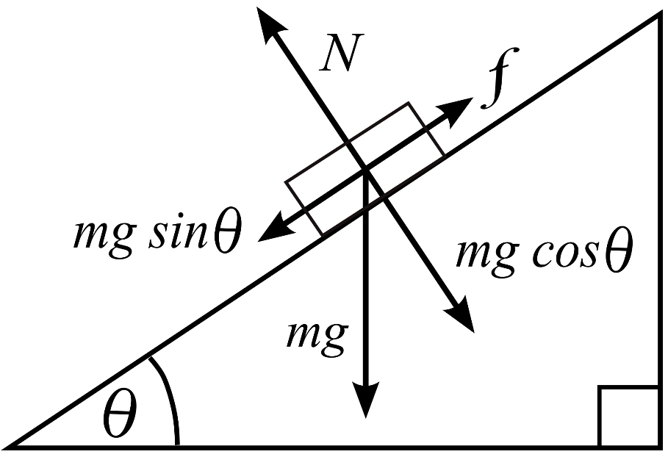

Slide 9
EXAMPLE
A particle of mass 5 Kg rests on a 30° inclined plane with the horizontal. A force F_{a} of magnitude 30 N acts on the particle in the direction parallel and up the inclined plane. a) Draw a Free Body Diagram including the particle, the inclined plane and all forces acting on the particle with their labels. b) Find the force of friction acting on the particle.

Slide 10
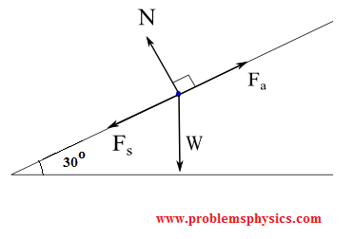
Solution
a) For the Free Body Diagram In the diagram below, W is the weight of the box, N the normal force exerted by the inclined plane on the box, F_{a} is the force applied to have the box in equilibrium and F_{s} the force of friction opposite F_{a}.
FIGURE For the Free Body Diagram

Slide 11
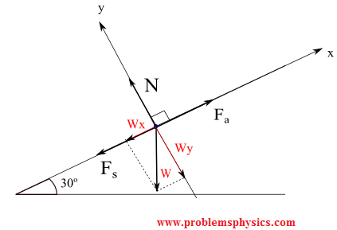
FIGURE For the Free Body Diagram of the forces

Slide 12
The box is at rest, hence its acceleration is equal to 0,
Therefore the sum of all forces acting on the box is equal to its mass times its acceleration which is zero. ( Newton's second law) SUM( F = ma), but a=0 so, F_{a} + W + N + F_{s} = 0
The components form of all forces (vectors) acting on the box are: F_{a} = (30 , 0) i.e in (x,y) components form |W| = 5 × 10 = 50 N W = (W_{x} , W_{y}) = ( - |W| sin(30°) , - |W| cos(30°)) = (- 50 sin (30°) , - 50 cos (30°) ) N = (0 , |N|) (No component along the x direction)

Slide 13
F_{s} = (-|F| , 0) (opposite direction to motion so –ve along x)
So, The F_{a} + W + N + Fs = 0 in components form is shown below
F_{a (Wx,Wy) N Fs}
(30 , 0) + (- 50 sin (30°) , - 50 cos (30°) ) + (0 , |N|) + (-|F| , 0) = 0
x components: 30 - 50 sin(30) + 0 - |F| = 0
|F| = - 50 sin(30) + 30 = 5 N
y components equation:
0 - 50 cos (30) + |N| + 0 = 0
|N| = 50 cos (30) = 25 √3 ≈ 43.3 N

